Slide 1
End-to-end learning geometries for graphs, dynamical systems, and regression
Brandon Amos • Meta AI, NYC
http://github.com/bamos/presentations
Joint work with Aaron Lou, Aram-Alexandre Pooladian, Carles Domingo-Enrich, Dishank Bansal, Maximilian Nickel, Mustafa Mukadam, Ricky Chen

Slide 2

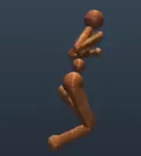
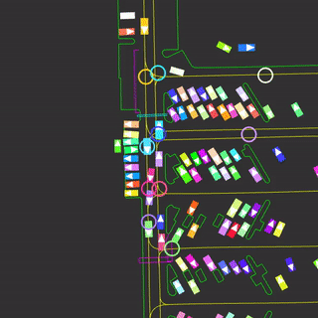
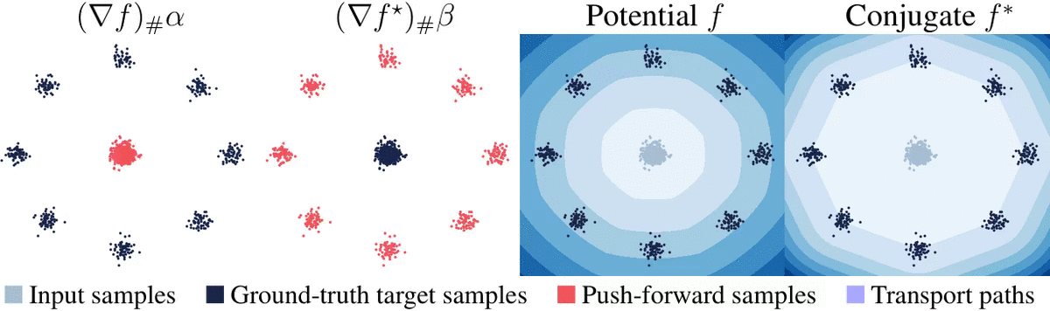
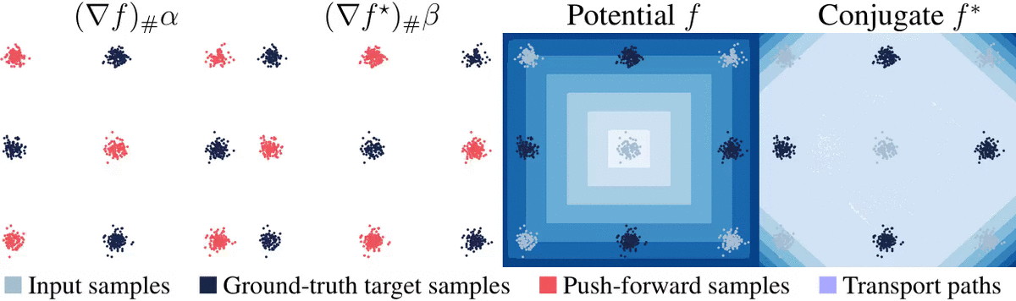
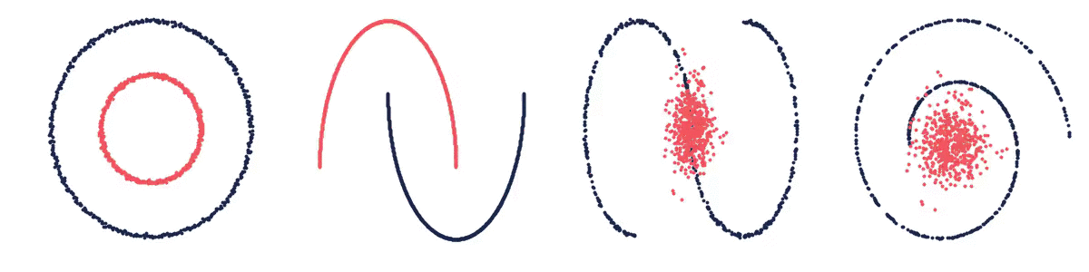
Disclaimer
optimization
machine learning
abstraction prediction
modeling
reasoning
interaction control
My main research is on (mostly Euclidean) optimization, control, and generative models
control
multi-agent dynamics
generative modeling and optimal transport
This talk: my perspective on intersections with learning graphs/geometry

Slide 3
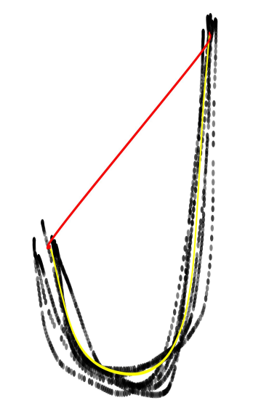
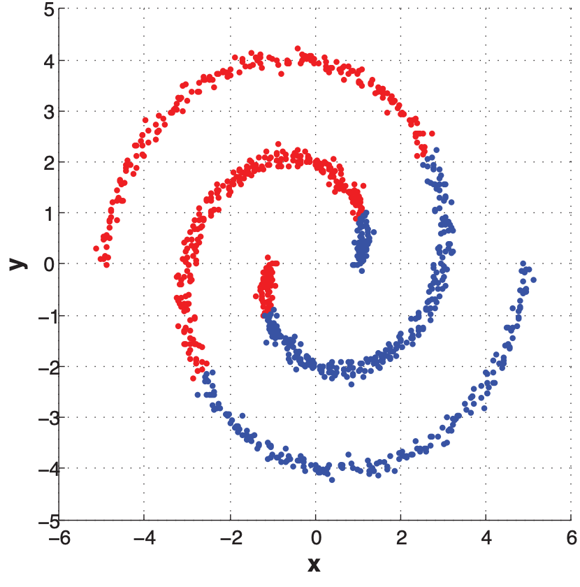
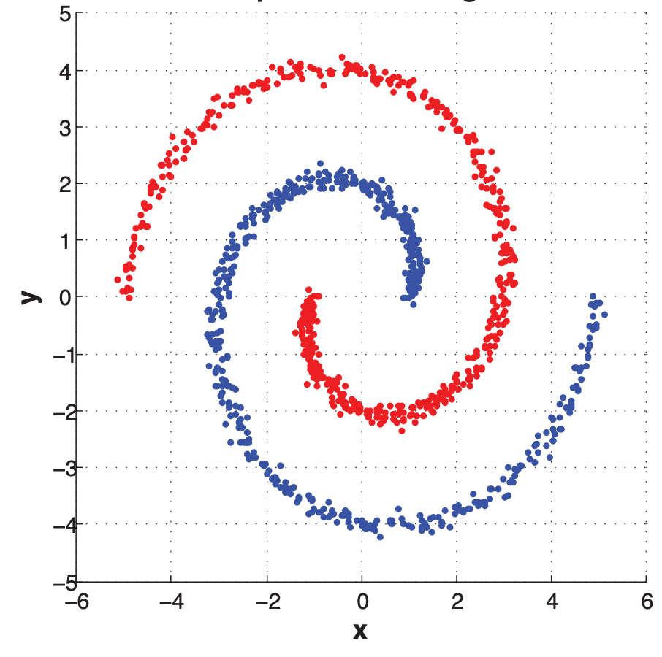
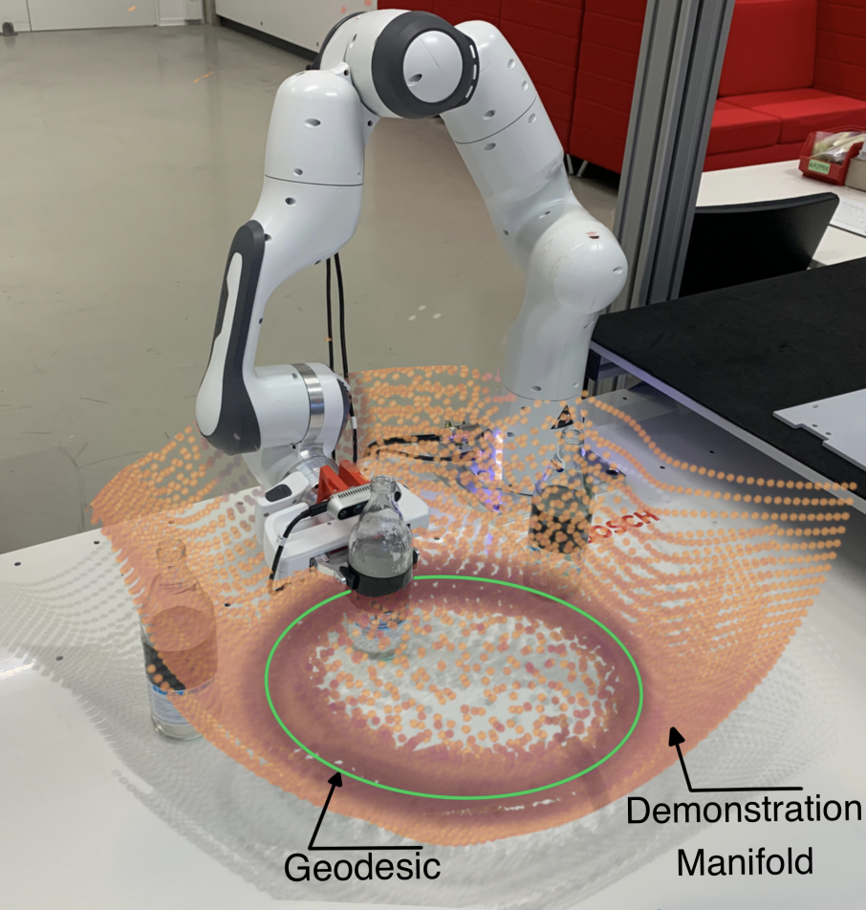
Why learn geometries?
(e.g., Manifolds, metrics, geodesic paths)
📚 Machine learning, a probabilistic perspective. Murphy, 2014.
📚 Only Bayes should learn a manifold. Hauberg, 2019.
📚 Learning Riemannian Manifolds for Geodesic Motion Skills. Beik-Mohammadi et al., RSS 2021.
Our focus: uncover underlying structure from high-dimensional data for predictions
Learning motion skills from demonstrations
k-means clustering (Euclidean)
spectral clustering (geometric)
Euclidean geodesic
learned geodesic
data
(demonstrations)
Image source: Murphy, Fig 24.11
Image source: Beik-Mohammadi

Slide 4
How to learn geometries?
parameterize the geometry
measure how well it works
metric (our focus)
surface
embeddings
latent models
fits to the data (standard)
geodesic distances
geodesic paths
surface reconstruction
works for a downstream task (our focus)

Slide 5
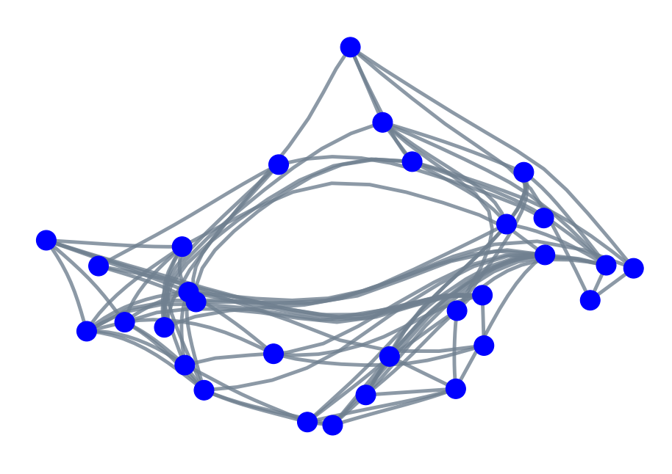
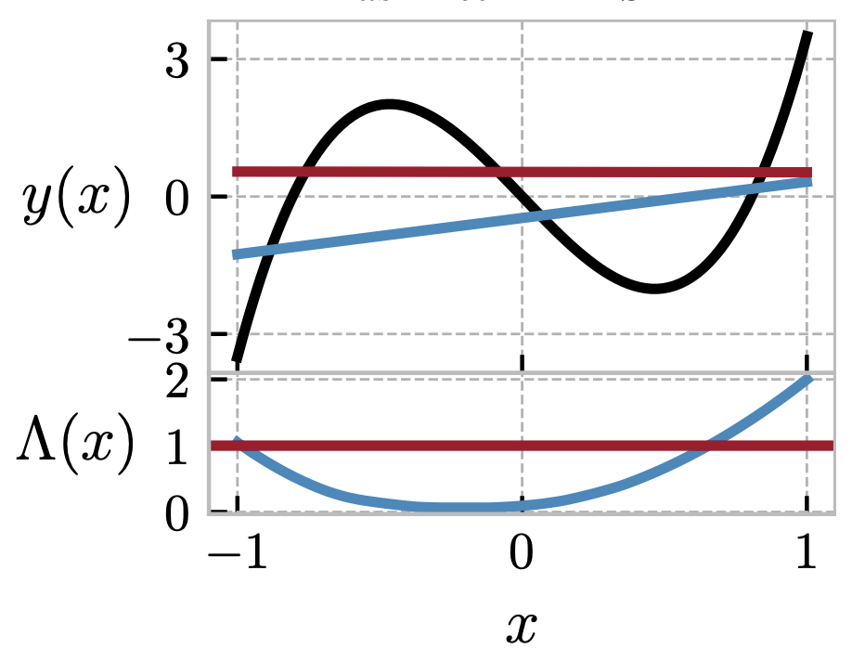
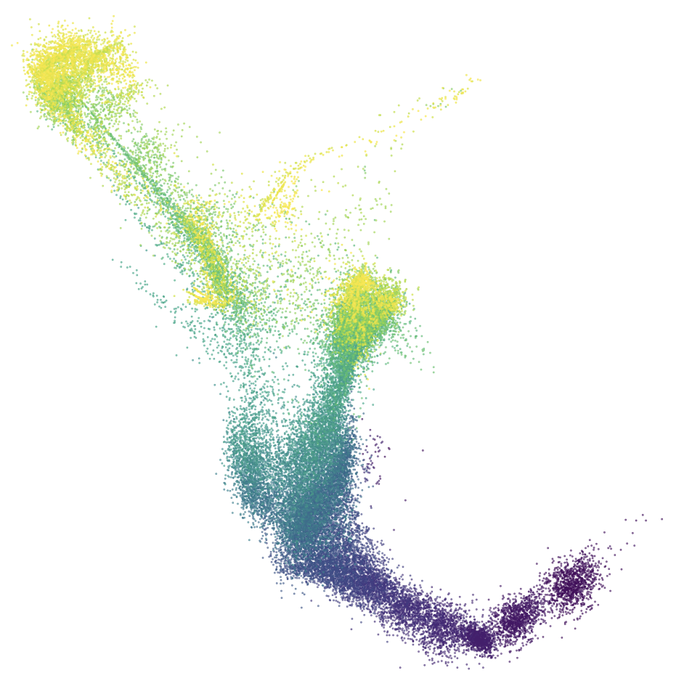

This talk: end-to-end learning geometries
1. graph embeddings
2. physical systems
3. regression
📚 Deep Riemannian Manifold Learning. Lou, Nickel, Amos, NeurIPS 2020 Geo4dl workshop.
📚 Learning Riemannian Manifolds for Geodesic Motion Skills. Beik-Mohammadi et al., RSS 2021.
📚 Riemannian Metric Learning via Optimal Transport. Scarvelis and Solomon, ICLR 2023.
📚 Neural Optimal Transport with Lagrangian Costs.
Pooladian, Domingo-Enrich, Chen, Amos, arXiv 2023.
📚 TaskMet: Task-Driven Metric Learning for Model Learning. Bansal, Chen, Mukadam, Amos, NeurIPS 2023.
protein graph embedded in $ℳ=(ℝ^{2}, A_{θ})$
linear regression
geodesics
node embeddings
robot demonstrations
cell populations over time

Slide 6
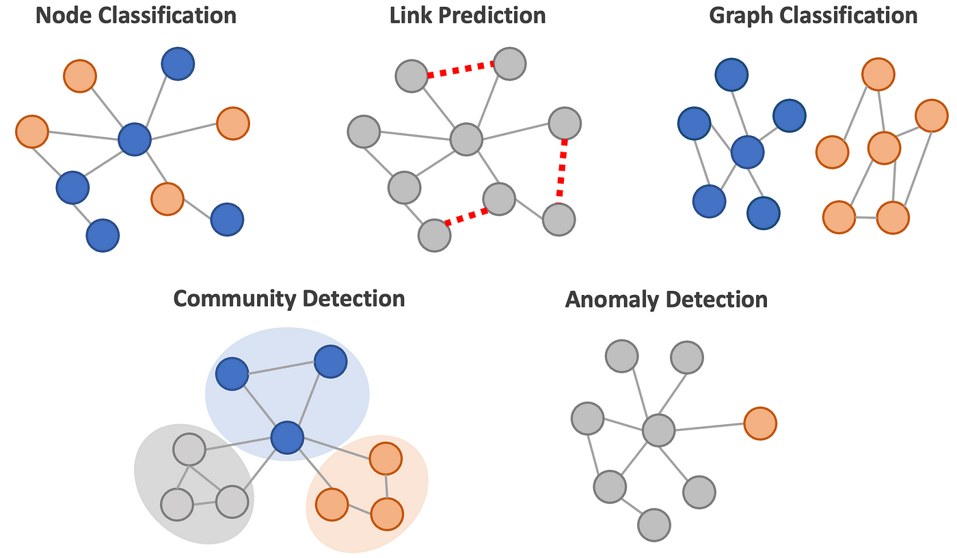
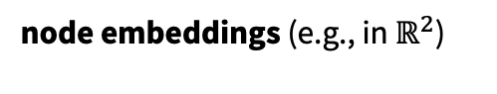
Graph embeddings
downstream task
graph
node embeddings (e.g., in $ℝ^{2}$)
Learning: optimize embeddings to preserve distances (or some other loss)
Image source: Masui

Slide 7
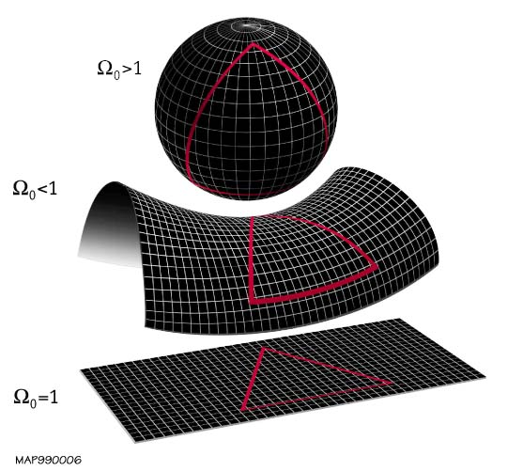
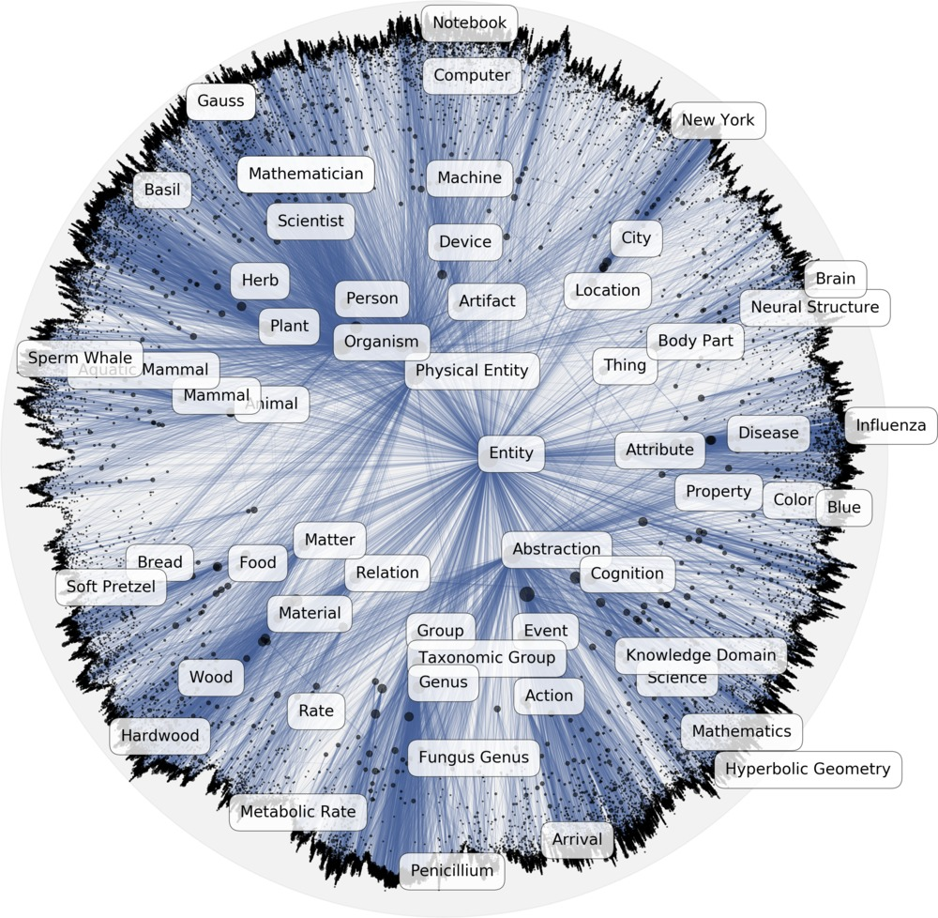
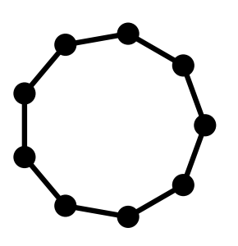
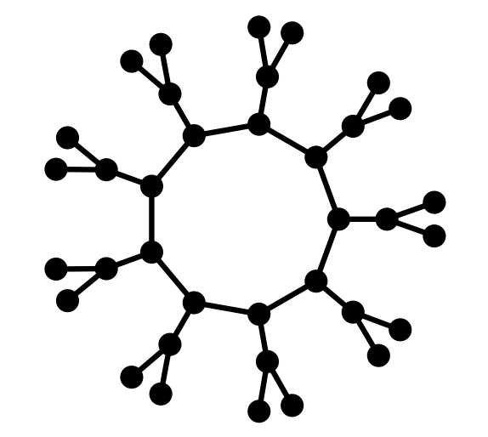
What’s the ideal geometry for the embeddings?
📚 Spherical and hyperbolic embeddings of data. Wilson et al., TPAMI 2014.
📚 Poincaré Embeddings for Learning Hierarchical Representations. Nickel and Kiela, NeurIPS 2017.
📚 Learning mixed-curvature representations in products of model spaces. Gu et al., ICLR 2019.
spherical
Euclidean space (general)
Hyperbolic space (hierarchies)
hyperbolic
Euclidean
Spherical space (cycles)
Product manifolds (mixtures)
Image source: Gu et al.
Image source: Nickel et al.
Image source: Gu et al.

Slide 8
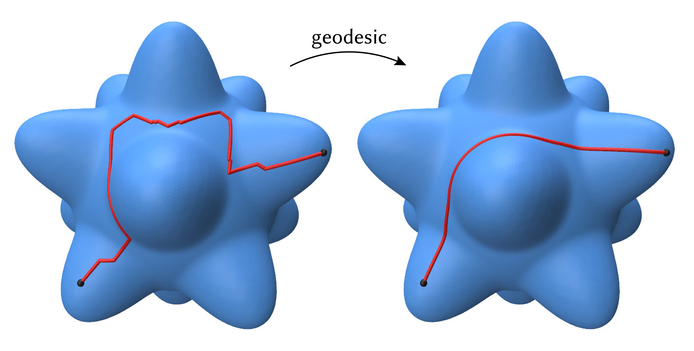

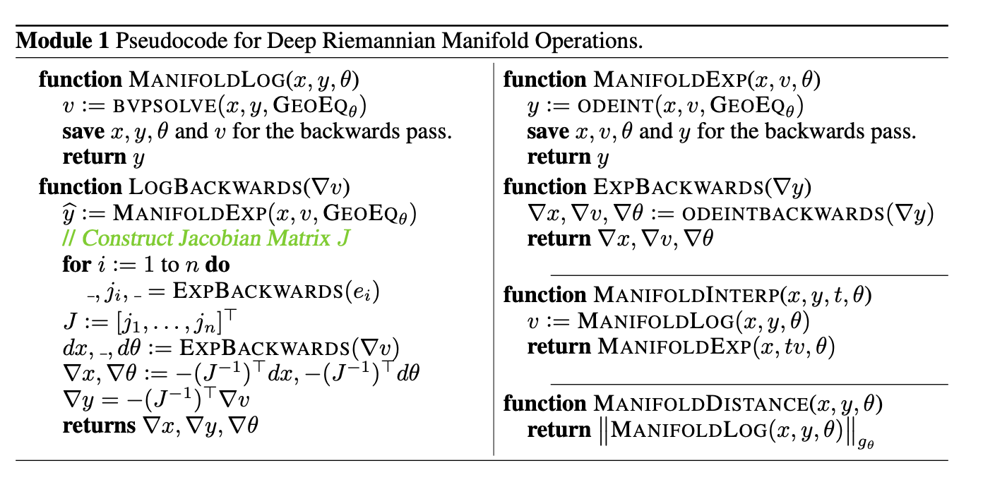
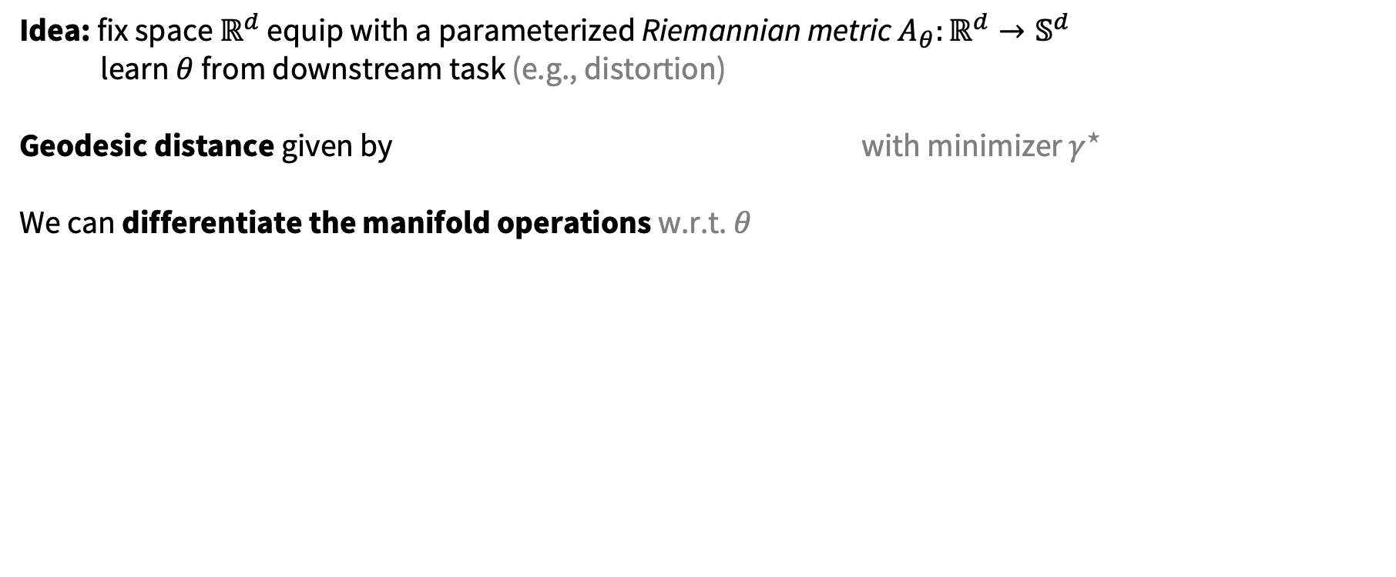



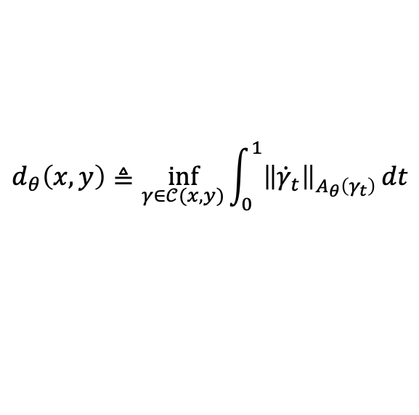
Learning the embedding geometry
📚 Deep Riemannian Manifold Learning. Lou, Nickel, Amos, NeurIPS 2020 Geo4dl workshop.
Idea: fix space $ℝ^{d}$ equip with a parameterized Riemannian metric $A_{θ}:ℝ^{d}→𝕊^{d}$
learn $θ$ from downstream task (e.g., distortion)
Geodesic distance given by with minimizer $γ^{⋆}$
We can differentiate the manifold operations w.r.t. $θ$
$$d_{θ}\left(x,y\right)≜\inf_{γ∈𝒞(x,y)}{\int_{0}^{1}{{\left\|{\dot{γ}}_{t}\right\|}_{A_{θ}\left(γ_{t}\right)}^{}}dt}$$
$$γ^{⋆}(x,y)$$
$$y$$
(numerically solved)
$$x$$
Image source

Slide 9
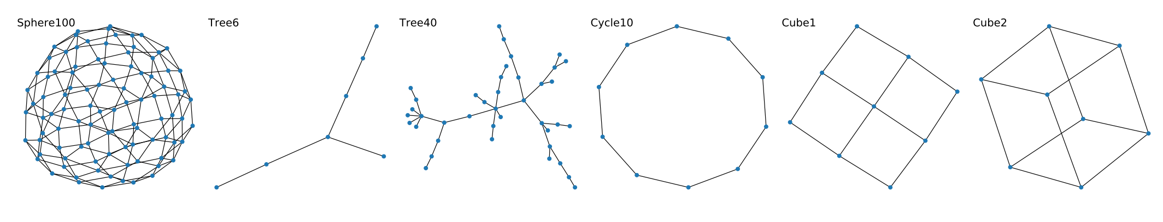
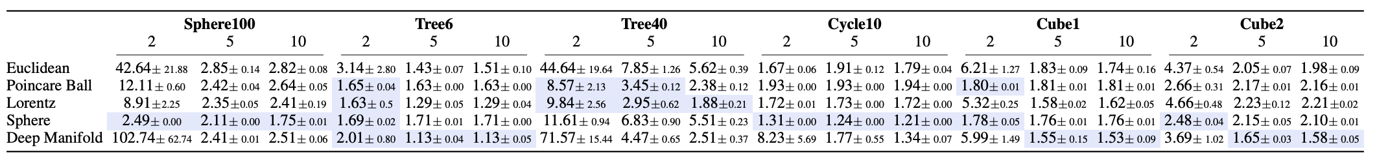
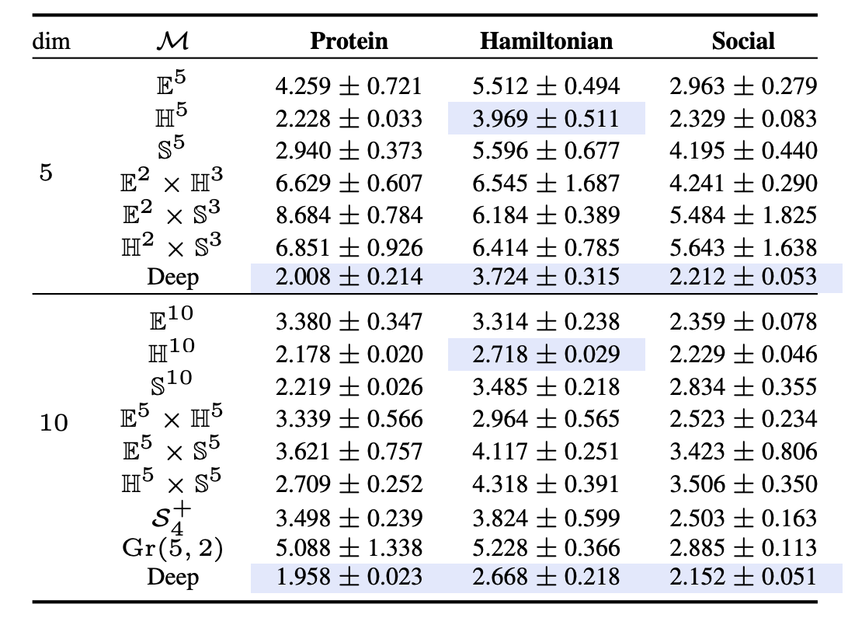
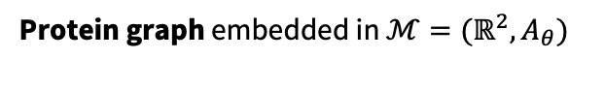
Graph embedding results
📚 Deep Riemannian Manifold Learning. Lou, Nickel, Amos, NeurIPS 2020 Geo4dl workshop.
Protein graph embedded in $ℳ=(ℝ^{2}, A_{θ})$
geodesics
node embeddings

Slide 10
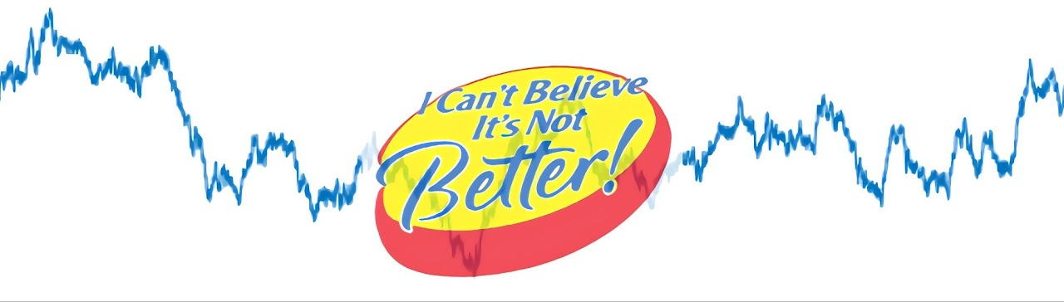

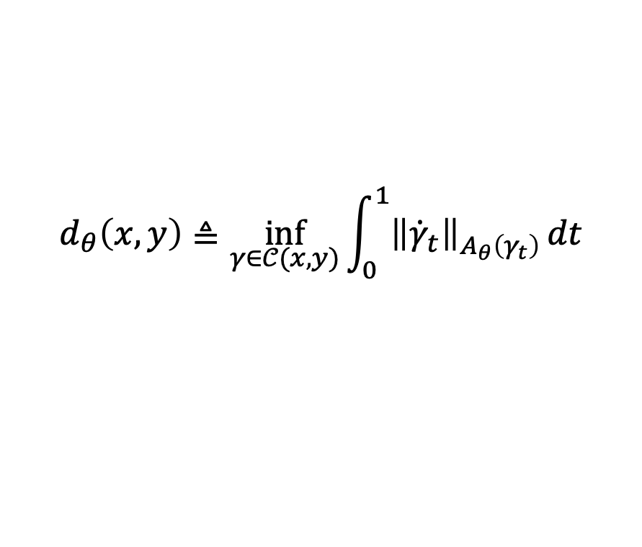
Scaling issues beyond ~10 dimensions
📚 Deep Riemannian Manifold Learning. Lou, Nickel, Amos, NeurIPS 2020 Geo4dl workshop.
Computing high-dimensional geodesics in a continuous space is hard
$$γ^{⋆}(x,y)$$
$$y$$
$$d_{θ}\left(x,y\right)≜\inf_{γ∈𝒞(x,y)}{\int_{0}^{1}{{\left\|{\dot{γ}}_{t}\right\|}_{A_{θ}\left(γ_{t}\right)}^{}}dt}$$
(very easy and scalable on, e.g., Euclidean, hyperbolic, spherical, and mixture spaces)
$$x$$
Image source

Slide 11

This talk: end-to-end learning geometries
1. graph embeddings
2. physical systems
3. regression
📚 Deep Riemannian Manifold Learning. Lou, Nickel, Amos, NeurIPS 2020 Geo4dl workshop.
📚 Learning Riemannian Manifolds for Geodesic Motion Skills. Beik-Mohammadi et al., RSS 2021.
📚 Riemannian Metric Learning via Optimal Transport. Scarvelis and Solomon, ICLR 2023.
📚 Neural Optimal Transport with Lagrangian Costs.
Pooladian, Domingo-Enrich, Chen, Amos, arXiv 2023.
📚 TaskMet: Task-Driven Metric Learning for Model Learning. Bansal, Chen, Mukadam, Amos, NeurIPS 2023.
protein graph embedded in $ℳ=(ℝ^{2}, A_{θ})$
linear regression
geodesics
node embeddings
robot demonstrations
cell populations over time

Slide 12
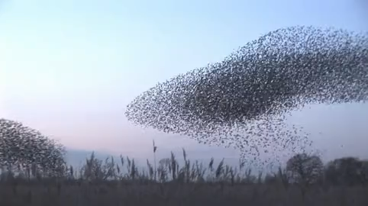
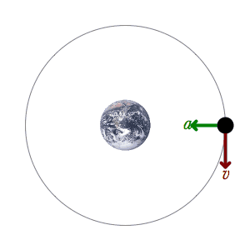
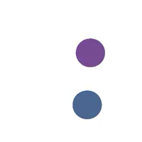
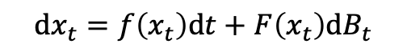
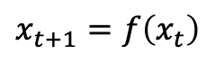
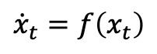
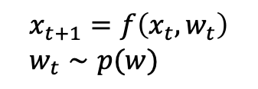
Modeling dynamical systems
Mechanics is the paradise of the mathematical sciences, because by means of it one comes to the fruits of mathematics.
da Vinci (1459-1519), Notebooks, v. 1, ch. 20.
📚 Quote also given at the beginning of Geometric Control of Mechanical Systems, Bullo and Lewis, 2000.
1. Make observations
2. Come up with a theory
Source
Continuous time
Discrete time
$${\dot{x}}_{t}=f\left(x_{t}\right)$$
Deterministic
$$x_{t+1}=f\left(x_{t}\right)$$
e.g., differential equations (ODE/PDEs)
e.g., Turing machines, games
$$\text{d}x_{t}=f\left(x_{t}\right)\text{d}t+F\left(x_{t}\right)\text{d}B_{t}$$
$$x_{t+1}=f\left(x_{t}, w_{t}\right) \\ w_{t}∼p(w)$$
Source
Stochastic
📚 Learning Neural Event Functions for Ordinary Differential Equations. Ricky T. Q. Chen, Brandon Amos, Maximilian Nickel, ICLR 2021.
e.g., Markov chains
e.g., stochastic differential equations

Slide 13
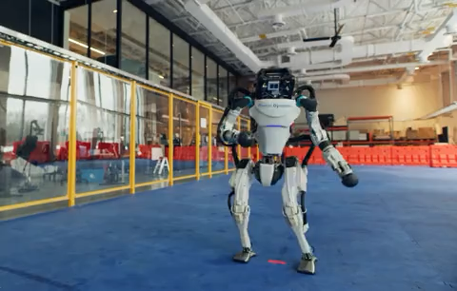
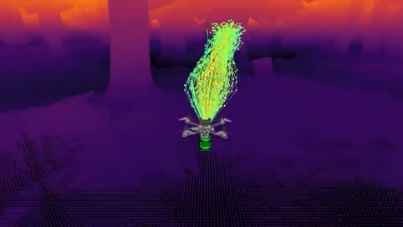
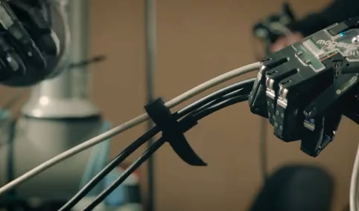
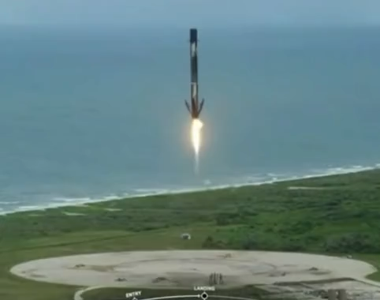
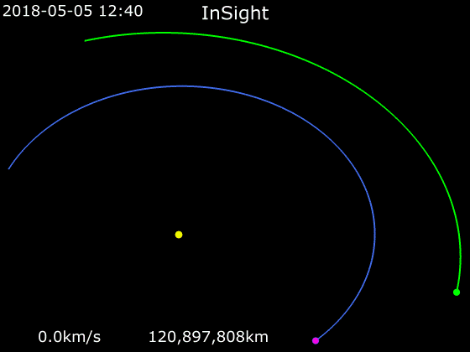
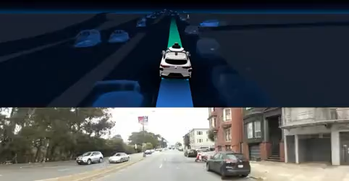
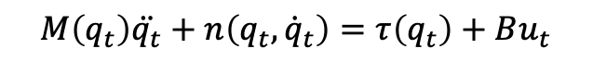
Controlled dynamical systems and robotics
often via the Newton-Euler equations of motion
$$M\left(q_{t}\right)\ddot{q_{t}}+n\left(q_{t},{\dot{q}}_{t}\right)=τ\left(q_{t}\right)+Bu_{t}$$
Source: Shadow Robotics
Source: Boston Dynamics
Learning high-speed flight. Loquercio et al., Science Robotics 2021.
Source: Waymo
Source: SpaceX
Dynamical Systems, the Three-Body Problem and Space Mission Design. Koon et al., 1999.

Slide 14
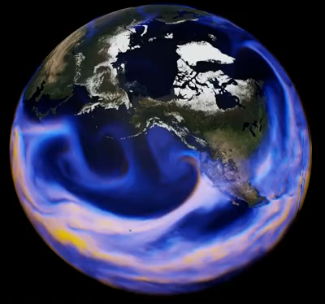
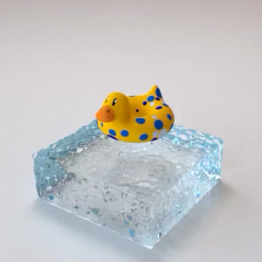
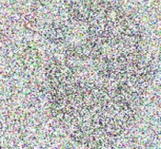
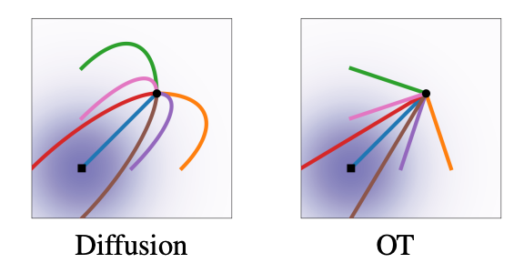
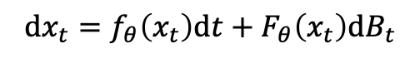
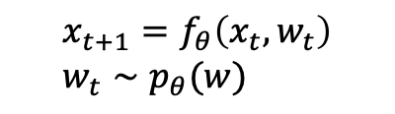
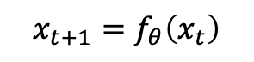
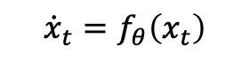
Machine learning way of learning dynamics
1. Collect data of the system
2. Throw neural networks at it
Continuous time
Discrete time
$${\dot{x}}_{t}=f_{θ}\left(x_{t}\right)$$
a neural network
a neural network
Deterministic
$$x_{t+1}=f_{θ}\left(x_{t}\right)$$
Source: NVIDIA
e.g., Neural ODEs/PDEs, neural operators
e.g., RNNs, LSTMs, Transformers for language and other discrete-time sequential data
📚 FourCastNet, Pathak et al., 2022.
📚 Learning Neural Constitutive Laws. Ma et al., ICML 2023.
$$\text{d}x_{t}=f_{θ}\left(x_{t}\right)\text{d}t+F_{θ}\left(x_{t}\right)\text{d}B_{t}$$
$$x_{t+1}=f_{θ}\left(x_{t}, w_{t}\right) \\ w_{t}∼p_{θ}(w)$$
neural networks
neural networks
Stochastic
e.g., RNNs with stochastic states
e.g., Neural SDEs, diffusion models, flow matching
📚 A Recurrent Latent Variable Model for Sequential Data. Chung et al., NeurIPS 2015.
📚 Sequential Neural Models with Stochastic Layers. Fraccaro et al., NeurIPS 2016.
📚 Deep unsupervised learning using nonequilibrium thermodynamics. Sohl-Dickstein et al., ICML 2015.
📚 Score-Based Generative Modeling through Stochastic Differential Equations. Song et al., ICLR 2021.
📚 Flow Matching for Generative Modeling. Lipman et al., ICLR 2023.
📚 Stochastic Interpolants. Albergo et al., ICLR 2023.

Slide 15




From Euclidean to geometric systems
why? modeling rotations, symmetries, obstacles, other parts of the open physical world
$${\dot{x}}_{t}=f\left(x_{t}\right)$$
where $x_{t}∈ℳ, {\dot{ x}}_{t}∈𝒯_{x_{t}}ℳ$
degrees of freedom of a rigid body in 3D space
Source

Slide 16


What if we don’t know the geometry? Learn it!
setting 1: geometry is the demonstration manifold
fit a VAE to the observations
induce a metric from it
compute geodesics under the induced metric
📚 Learning Riemannian Manifolds for Geodesic Motion Skills. Beik-Mohammadi et al., RSS 2021.
Euclidean geodesic
learned geodesic
data
(demonstrations)
$$d_{θ}\left(x,y\right)≜\inf_{γ∈𝒞(x,y)}{\int_{0}^{1}{\frac{1}{2}{\left\|{\dot{γ}}_{t}\right\|}_{M_{θ}\left(γ_{t}\right)}^{}}dt}$$
geodesic solver: with splines (usually in 2 or 3 dimensions)

Slide 17

What if we don’t know the geometry? Learn it!
setting 2: geometry is in the state space (particle system with unpaired data)
📚 Riemannian Metric Learning via Optimal Transport. Scarvelis and Solomon, ICLR 2023.
📚 Neural Optimal Transport with Lagrangian Costs. Pooladian, Domingo-Enrich, Chen, Amos, arXiv 2023.
populations of cells over time
synthetic data

Slide 18





What if we don’t know the geometry? Learn it!
setting 2: geometry is in the state space (particle system with unpaired data)
📚 Riemannian Metric Learning via Optimal Transport. Scarvelis and Solomon, ICLR 2023.
📚 Neural Optimal Transport with Lagrangian Costs. Pooladian, Domingo-Enrich, Chen, Amos, arXiv 2023.
parameterize the geometry
solve OT problem in that geometry
improve the metric
via a metric $A$
so the OT cost is lower

Slide 19

What if we don’t know the geometry? Learn it!
setting 2: geometry is in the state space (particle system with unpaired data)
📚 Riemannian Metric Learning via Optimal Transport. Scarvelis and Solomon, ICLR 2023.
📚 Neural Optimal Transport with Lagrangian Costs. Pooladian, Domingo-Enrich, Chen, Amos, arXiv 2023.

Slide 20
This talk: end-to-end learning geometries
1. graph embeddings
2. physical systems
3. regression
📚 Deep Riemannian Manifold Learning. Lou, Nickel, Amos, NeurIPS 2020 Geo4dl workshop.
📚 Learning Riemannian Manifolds for Geodesic Motion Skills. Beik-Mohammadi et al., RSS 2021.
📚 Riemannian Metric Learning via Optimal Transport. Scarvelis and Solomon, ICLR 2023.
📚 Neural Optimal Transport with Lagrangian Costs.
Pooladian, Domingo-Enrich, Chen, Amos, arXiv 2023.
📚 TaskMet: Task-Driven Metric Learning for Model Learning. Bansal, Chen, Mukadam, Amos, NeurIPS 2023.
protein graph embedded in $ℳ=(ℝ^{2}, A_{θ})$
linear regression
geodesics
node embeddings
robot demonstrations
cell populations over time

Slide 21

The geometry of the prediction space
📚 TaskMet: Task-Driven Metric Learning for Model Learning. Bansal, Chen, Mukadam, Amos, NeurIPS 2023.
linear regression
$$\min_{θ}{𝔼_{\left(x,y\right)∼𝒟} {\left\|f_{θ}\left(x\right)−y\right\|}_{Λ\left(x\right)}^{2}}$$
Euclidean
non-Euclidean
(metric)

Slide 22





Why learn the prediction space geometry?
📚 TaskMet: Task-Driven Metric Learning for Model Learning. Bansal, Chen, Mukadam, Amos, NeurIPS 2023.
Reason 2. Emphasize predictions for class 1 over 2
Reason 3. Emphasize predictions for image A over B
Reason 1. Emphasize predictions for y₁ by making the loss higher

Slide 23
Why learn the prediction space geometry?
📚 TaskMet: Task-Driven Metric Learning for Model Learning. Bansal, Chen, Mukadam, Amos, NeurIPS 2023.
problem: where does the geometry come from?
Reason 2. Emphasize predictions for class 1 over 2
Reason 3. Emphasize predictions for image A over B
Reason 1. Emphasize predictions for y₁ by making the loss higher

Slide 24

Prediction geometry comes from downstream tasks
📚 TaskMet: Task-Driven Metric Learning for Model Learning. Bansal, Chen, Mukadam, Amos, NeurIPS 2023.

Slide 25


How to use the task information?
📚 TaskMet: Task-Driven Metric Learning for Model Learning. Bansal, Chen, Mukadam, Amos, NeurIPS 2023.
Standard end-to-end task-based learning 📚 Task-based end-to-end model learning in stochastic optimization. Donti, Amos, and Kolter, NeurIPS 2017.
📚 Decision-Focused Learning for Combinatorial Optimization. Wilder et al., AAAI 2019.
📚 Smart ”Predict, then optimize.” Elmachtoub and Grigas, Management Science 2022.
Our approach: TaskMet
Task information only influences the prediction loss, not the model
Why? To retain the original prediction task
✔ Uses predictive and task information
✔ Prediction model is better at predicting
✔ Prediction model more likely to generalize to other tasks
✔ Competitive performance with other task-based learning methods
✔ Uses predictive and task information
❌ Prediction model may forget about the prediction task
❌ Prediction model may not generalize beyond the training task

Slide 26




Parameterizing the geometry: Mahalanobis metrics
📚 TaskMet: Task-Driven Metric Learning for Model Learning. Bansal, Chen, Mukadam, Amos, NeurIPS 2023.
1. relative importance of features up/down-weighting based on importance 2. relative importance of samples via heteroscedastic metric $Λ\left(x\right)$

Slide 27




End-to-end learning the geometry
📚 TaskMet: Task-Driven Metric Learning for Model Learning. Bansal, Chen, Mukadam, Amos, NeurIPS 2023.
Formulate as a bilevel optimization problem
$$φ^{⋆} ≔\underset{φ}{argmin}{ℒ_{\text{task}}(θ^{⋆}\left(φ\right))}$$
optimize the metric with the task loss
$$\text{w}\text{here} { θ}^{⋆}\left(φ\right)=\underset{θ}{argmin}{ℒ_{\text{pred}}(θ, φ)}$$
solve the regression problem under that metric
$$∇_{φ}ℒ_{\text{task}}\left(θ^{⋆} \left(φ\right)\right)=∇_{θ}ℒ_{\text{task}}\left(θ\right){\left.​\right|}_{θ=θ^{⋆} \left(φ\right)}⋅\underbrace{\frac{∂ θ^{⋆} \left(φ\right)}{∂φ}}$$
calculate using the implicit function theorem
$${\left( \frac{∂ℒ_{\text{pred}}\left(θ, φ\right)}{∂^{2} θ}\right)}^{−1}⋅\frac{∂ℒ_{\text{pred}}\left(θ, φ\right)}{∂φ ∂θ}{\left.​\right|}_{θ=θ^{⋆} \left(φ\right)}$$

Slide 28


Experimental results
📚 TaskMet: Task-Driven Metric Learning for Model Learning. Bansal, Chen, Mukadam, Amos, NeurIPS 2023.
Learning MDP dynamics with distractors 📚 Control-oriented model-based reinforcement learning with implicit differentiation. Nikishin et al., AAAI 2022.
✔ state-of-the-art task performance ✔ lower prediction error
Standard DFL settings 📚 Decision-focused learning without decision-making. Shah et al., NeurIPS 2022. ✔ near-optimal task performance ✔ lower prediction error

Slide 29

End-to-end learning geometries for graphs, dynamical systems, and regression
Brandon Amos • Meta AI, NYC
http://github.com/bamos/presentations
1. graph embeddings
2. physical systems
3. regression
📚 Deep Riemannian Manifold Learning. Lou, Nickel, Amos, NeurIPS 2020 Geo4dl workshop.
📚 Learning Riemannian Manifolds for Geodesic Motion Skills. Beik-Mohammadi et al., RSS 2021.
📚 Riemannian Metric Learning via Optimal Transport. Scarvelis and Solomon, ICLR 2023.
📚 Neural Optimal Transport with Lagrangian Costs.
Pooladian, Domingo-Enrich, Chen, Amos, arXiv 2023.
📚 TaskMet: Task-Driven Metric Learning for Model Learning. Bansal, Chen, Mukadam, Amos, NeurIPS 2023.
protein graph embedded in $ℳ=(ℝ^{2}, A_{θ})$
linear regression
geodesics
node embeddings
robot demonstrations
cell populations over time

